Slide 1
NANE: Neighborhood, Amenity, Noise, and Emotion feature impact in Real Estate Housing Price Prediction
Brianna Malone & Alvaro Tapia

Slide 2
Project Outline
Introduction
Literature Review
Novelty & Contribution
Methodology
Implementation & Results
- Feature Importance
- Machine Learning (RMSE and MAE)
Conclusion
Future Work

Slide 3

Introduction
Real Estate Price Prediction a 10 year study.
Real Estate investment comprises 10% of Gross Domestic Product.
Solve inaccurate predictions from platforms such as Zillow, & Trulia.
The proposed NANE categories are expected to outperform parent paper’s results.
Planned to find the best model among others through rigorous testing.

Slide 4
Literature Review
PATE: Property, Amenities, Traffic, and Emotions Coming Together for Real Estate Price Prediction
Does Noise Affect Housing Prices? A Case Study in the Urban Area of Thessaloniki
The Economic Value of Neighborhoods: Predicting Real Estate Prices From the Urban Environment
Link to Papers !
Link to Paper 1
Link to Paper 2
Link to Paper 3

Slide 5
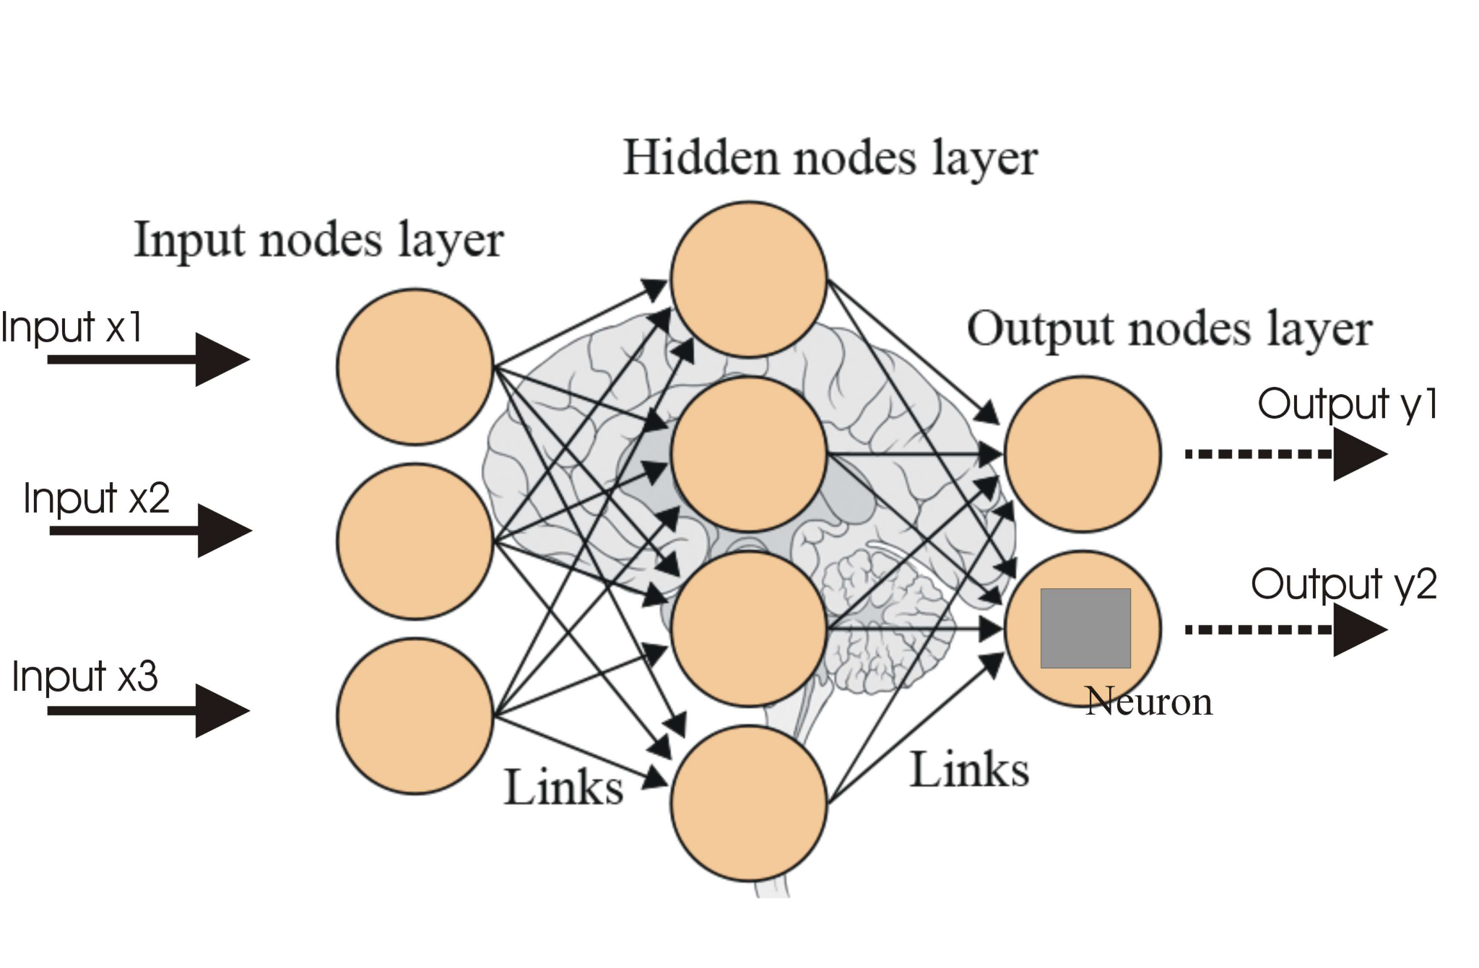
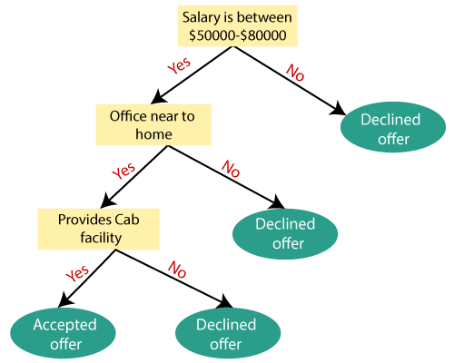
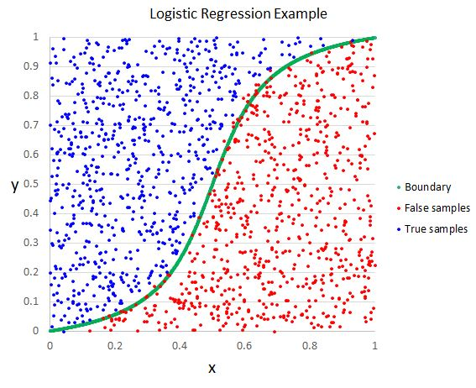
Novelty & Contributions
Different approach: Dataset with new features, and new models to analyze.
Changed feature importance process. Replace F-Score with Random Forest Classifier.
Dropped unwanted and non-important features based on Correlation Matrix and Feature Importance.
Proposed new models: Neural Networks, Decision Trees, and Logistic Regression.
Goal: Use different ML models to find the best one based on the parameters selected, to find the best RMSE, and MAE.

Slide 6
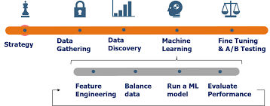
Methodology
Original Data → (data.csv) from our parent paper (Paper 1)
A.) Feature Engineering → (RF) Importance and Selection
B.) Machine Learning Models
→ Train set with 75%, Test set with 10% Validation set with 15%.
→ Find RMSE and MAE to measure Error
C.) Creation of visualization tools
→ Matrix plot, bar plot, scatterplots

Slide 7
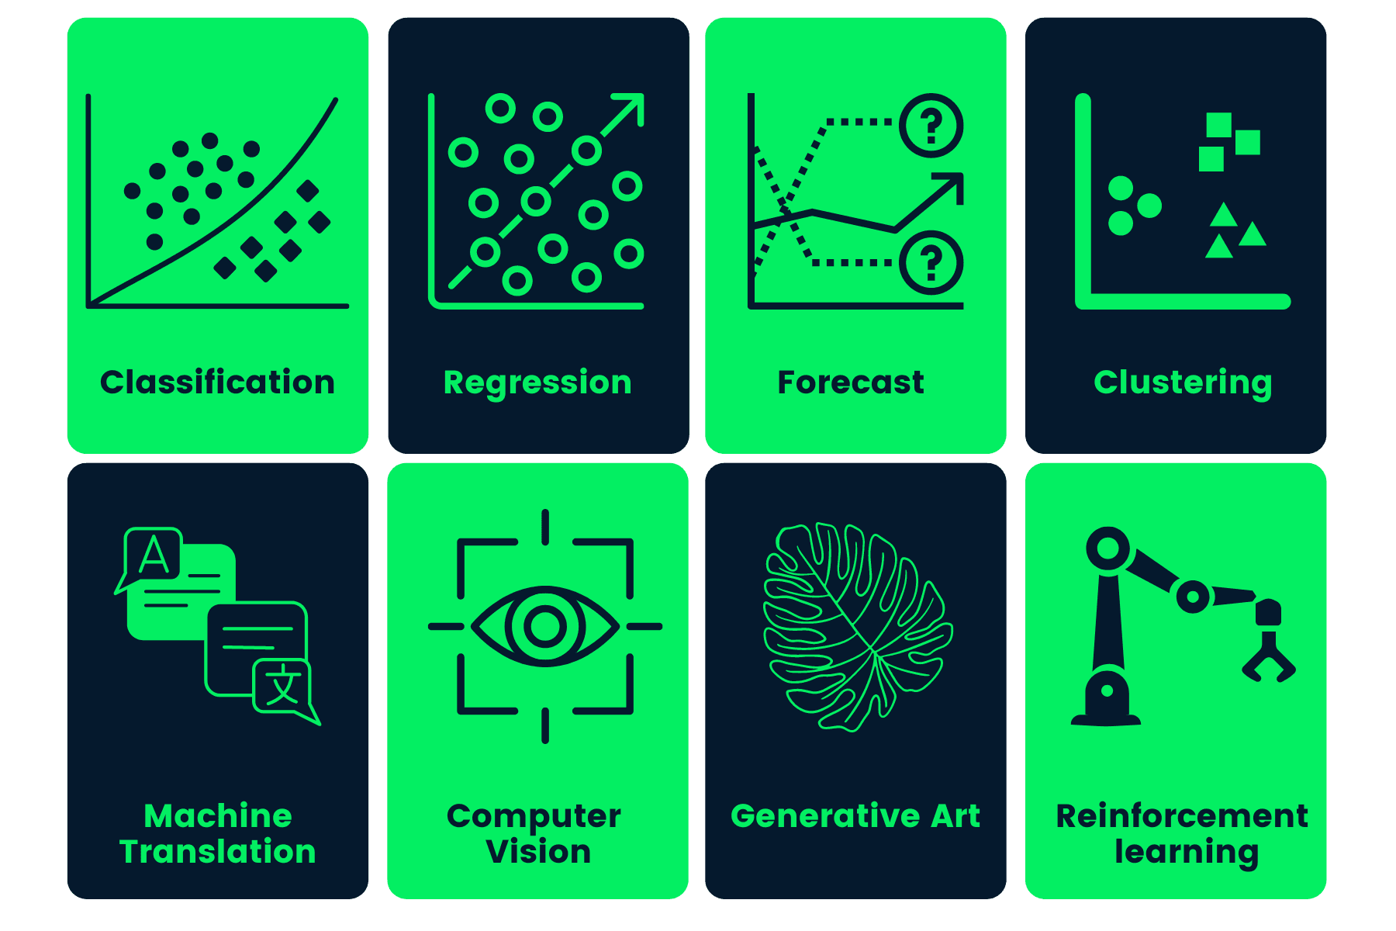
Methodology - Machine Learning
* Neural Network → 64 input layer units, 32 hidden units, 1 output unit layer (TensorFlow Keras API)
* Decision Tree → hyperparameters setting the random state of the model with 42 ; reproducibility
XGBoost → hyperparameters setting the random state of the model with 42 ; reproducibility
* Logistic Regression → regression set a 42 random state, utilized the scikit-learn python package.
GOAL : is to find which model is best a housing price predictions

Slide 8
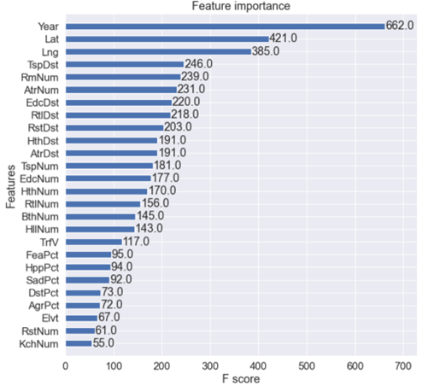
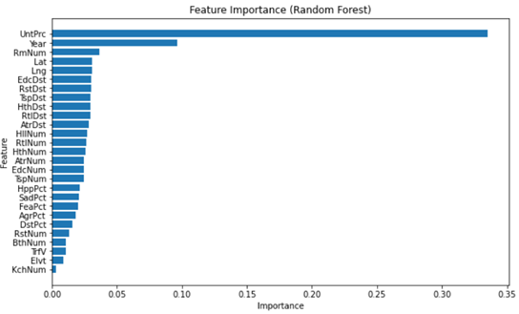
Implementation & Results
FEATURE IMPORTANCE
Achieved a better performance when performing Feature Importance using Random Forest Classifier (RFC).
RFC handles overfitting and useful when using large datasets.
Focused on determining the most impactful features vs. price.
Parent paper
Project

Slide 9
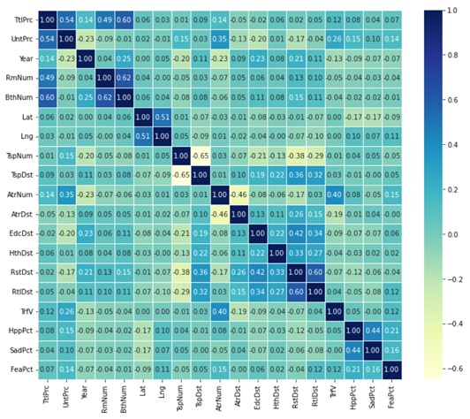
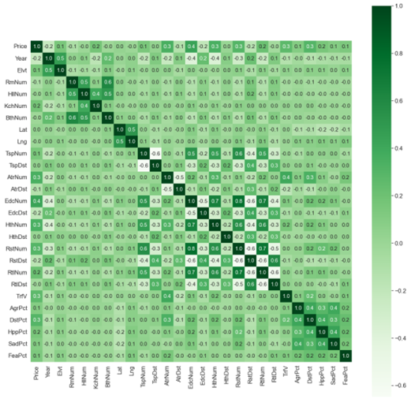
Implementation & Results
Parent paper
FEATURE SELECTION
The R-value is a number range between −1 and 1.
Narrowed down the list of variables to focus on that had a greater impact on price valuations. Left with 19 variables.
Dropped the following parameters: 'Elvt', 'KchNum', 'HllNum', 'EdcNum', 'HthNum', 'RtlNum', 'RstNum', 'DstPct', 'AgrPct'.
Performed correlation matrix to validate the right selection of features .
Project

Slide 10
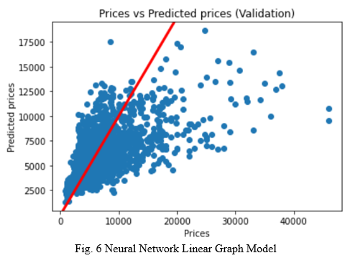
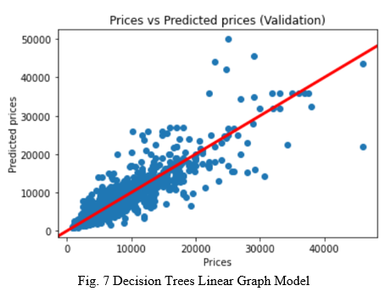
Implementation & Results
MACHINE LEARNING MODEL (1): NEURAL NETWORK & DECISION TREES
Both very inefficient besides choosing the best hyperparameters.
Very dispersed data points away from the trend line.

Slide 11
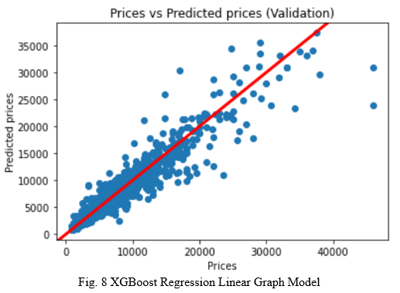
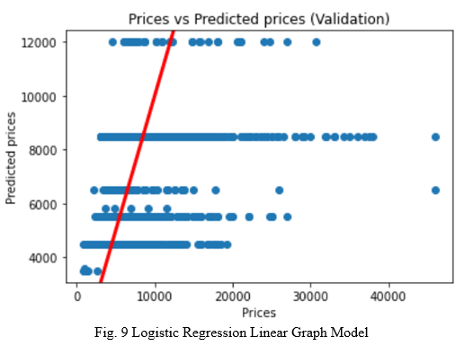
Implementation & Results
MACHINE LEARNING MODEL (2): XGBOOST REG. & LOGISTIC REG.
Huge improvement in the models and linear graph.
More cumulative data points near the trend line.
XGBoost is the best model for Housing Price Prediction.

Slide 12
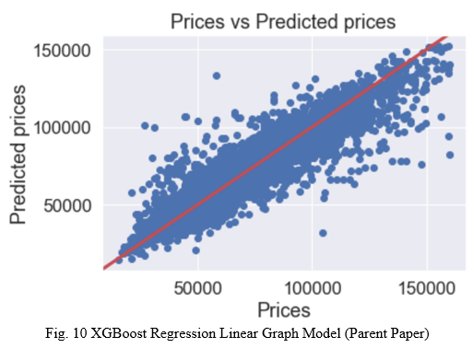
FINAL COMPARISON

Slide 13
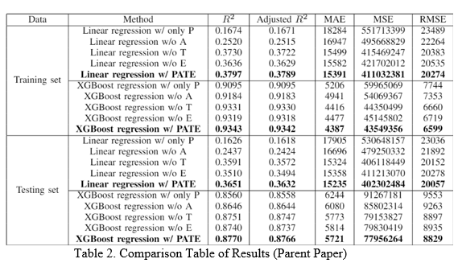
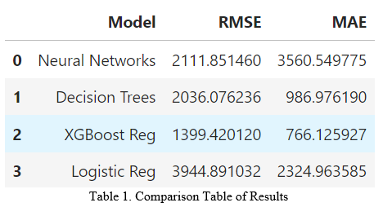
FINAL COMPARISON
Parent Paper
Project

Slide 14
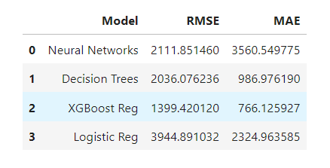
Conclusion
XGBoost is the best performing model from the NANE parameters that were selected.
NANE feature showed improvement in the machine learning model performance

Slide 15

Future Work
Potential Future Investigations:
Combine textual features with imagine features.
Investigate and analyze time as a potential variable. Future price prediction.
Study users reviews to increase the accuracy of model predictions.
Hope to bring value to users with this Research Paper.

Slide 16
Thank You
Link to Paper Information: https://github.com/abt5572/DS340W-Group10

